Slide 1

Healthcare Patient Analysis Dashboard
Transforming raw data into actionable insights for strategic healthcare decisions.

Slide 2

Project Overview: From Data to Insight
Data Preparation
Interactive Dashboard
Comprehensive cleaning and preprocessing of patient records.
Development of a dynamic Power BI dashboard for intuitive exploration.
Key Metric Analysis
Flexible Filtering
In-depth review of demographics, billing, and health conditions.
Enabled robust slicers for condition and year-based data segmentation.

Slide 3

Rigorous Data Cleaning Steps
Duplicate & Null Removal
Ensuring data integrity by eliminating redundant or empty entries.
Standardized Naming
Consistent column names for uniform analysis.
Value Validation
Accurate age and billing information verification.
Consistent Formatting
Uniform data types and formats across the dataset.
Calculated Fields
Creating new metrics for deeper insights.

Slide 4
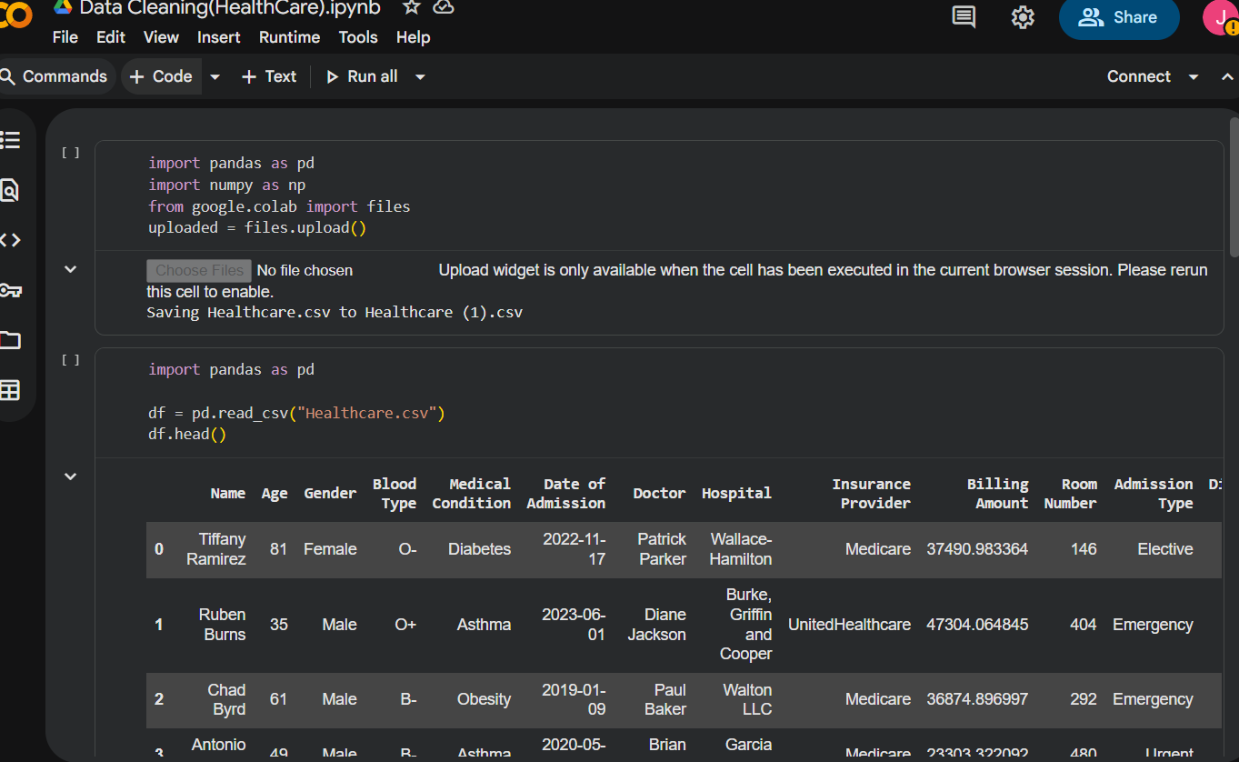
Data Import & Initial Exploration
Imported libraries: pandas, numpy, google.colab files
Uploaded raw dataset: Healthcare.csv
Performed initial checks:
df.head() → preview first rows
df.shape, df.info() → dataset size & structure
df.isnull().sum() → missing values count
df.describe() → statistical summary

Slide 5
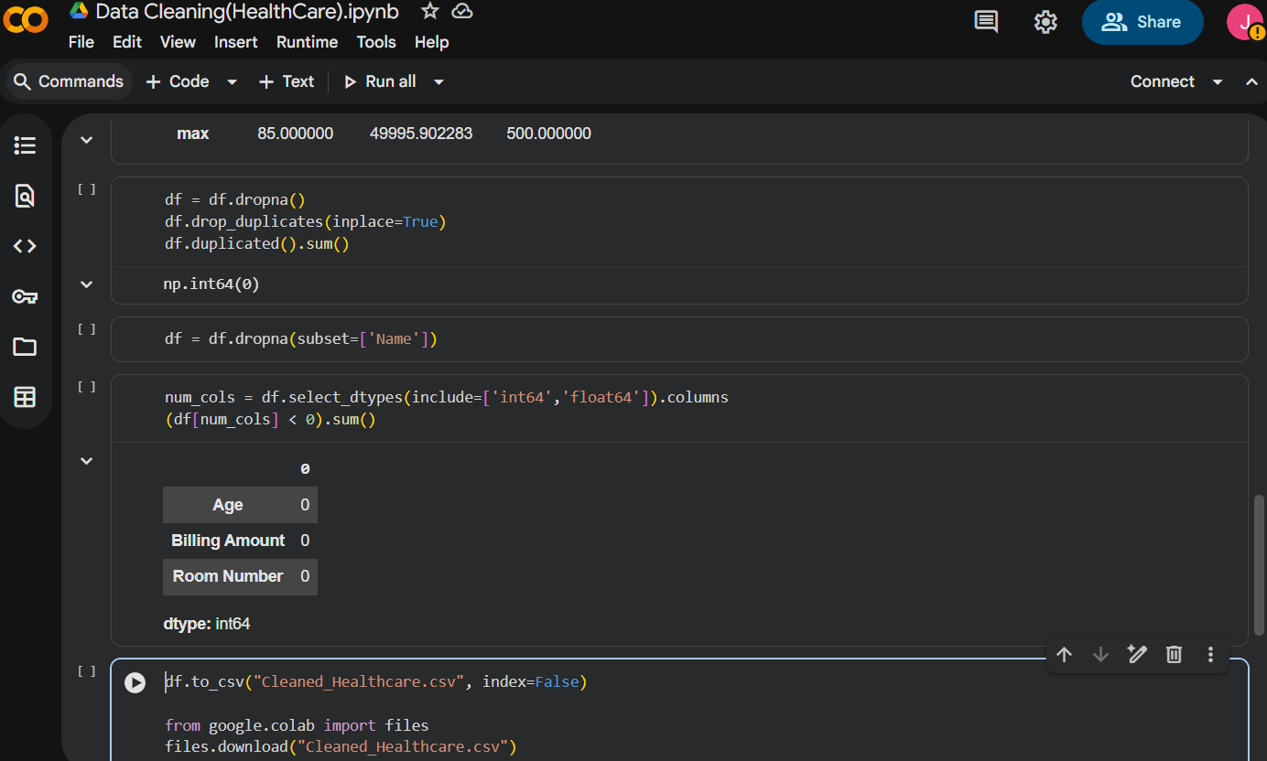
Cleaning Operations
Handled Missing Data
Dropped rows with null values (df.dropna())
Ensured Name column has no missing entries (df.dropna(subset=['Name']))
Removed Duplicates
Dropped duplicate rows (df.drop_duplicates(inplace=True))
Verified duplicates count (df.duplicated().sum())
Validated Numeric Columns
Selected numeric columns (select_dtypes)
Checked for negative values → flagged anomalies

Slide 6
Export & Next Steps
Exported cleaned dataset: Cleaned_Healthcare.csv
Downloaded file for further use (files.download)
Outcome:
Dataset is consistent, duplicate‑free, and ready for analysis
Prepared for dashboarding, visualization, and patient insights

Slide 7

Intuitive Dashboard Design Approach
Simple & Clean Layout
KPI Emphasis
Prioritizing clarity and ease of navigation for users.
Key Performance Indicators prominently displayed at the top.
Visualized Data
Thematic Consistency
Appropriate chart types selected for optimal data comprehension.
Harmonized colors and formatting for a professional look.

Slide 8
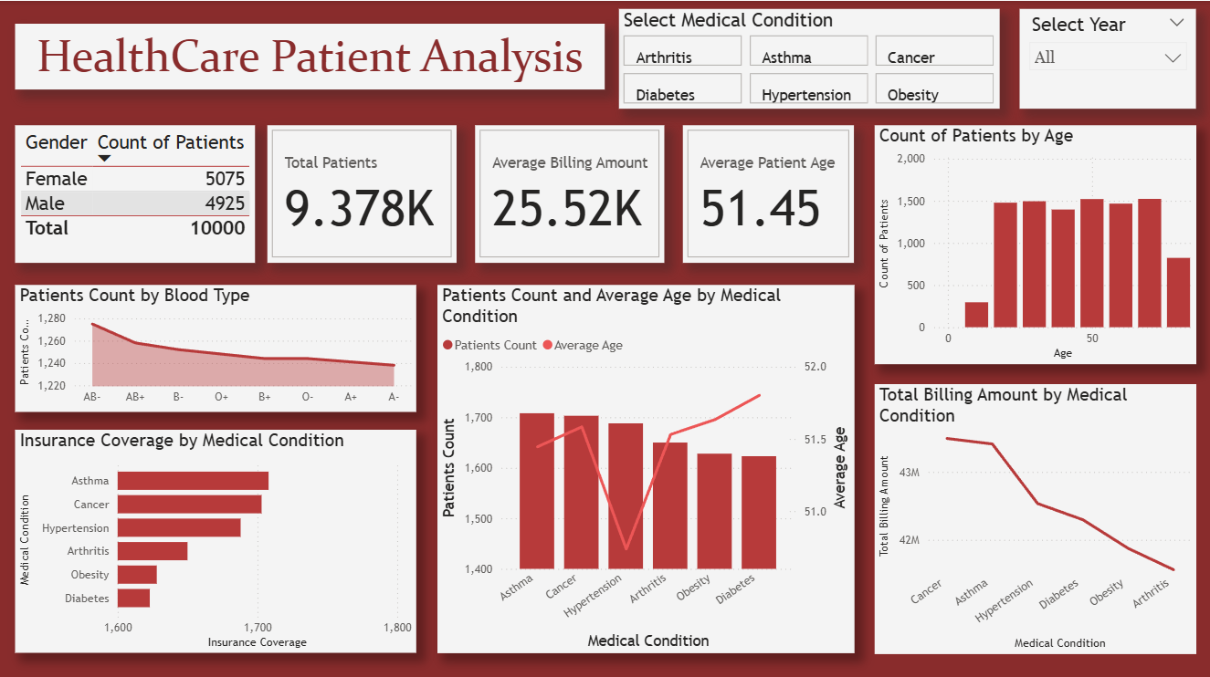

Slide 9
Gender Distribution
Female Patients: 5,075
Male Patients: 4,925
Total: 10,000
Insight: Balanced gender split → outreach strategies can remain uniform across genders

Slide 10
Blood Type Distribution
Blood types evenly spread (~1,220–1,280 patients each)
Insight: No skew toward any blood type; distribution is stable

Slide 11
Age Distribution
Peak patient count in 40–60 age range (~2,000 patients)
Insight: Chronic conditions most prevalent in middle‑aged and older populations

Slide 12
Insurance Coverage by Condition
Highest coverage: Asthma (~1,780)
Lowest coverage: Diabetes (~1,640)
Insight: Coverage gaps exist for diabetes & obesity → affordability risks

Slide 13
Patient Count by Condition
Patient counts range ~1,500–1,750 per condition
Insight: Conditions affect similar volumes of patients; chronic diseases dominate

Slide 14
Average Age by Condition
Average age across conditions: 51–52 years
Insight: All conditions skew toward older populations → care strategies should target 50+

Slide 15
Total Billing by Condition
Highest billing: Cancer (~43M)
Lowest billing: Arthritis (~41.5M)
Insight: Cancer drives highest costs → resource allocation and preventive programs critica

Slide 16

Key Performance Indicators
9.3K+
25.52K
51+
Balanced
Total Patients
Average Billing
Average Age
Gender Split
Extensive dataset provides a robust analytical foundation.
Understanding the financial aspects of patient care.
Demographic insights for targeted healthcare strategies.
Even distribution across genders allows for comprehensive analysis.

Slide 17
Core Patient Care Metrics
Content:
Total Patients: 9.3K+ → robust dataset for analysis
Average Billing: 25.52K → financial insights into patient care costs
Average Age: 51+ years → demographic skew toward middle‑aged population
Gender Split: Balanced (Female: 5,075 | Male: 4,925) → uniform outreach strategies
Insight: KPIs provide a quick snapshot of patient volume, cost, and demographics for decision‑makers.

Slide 18
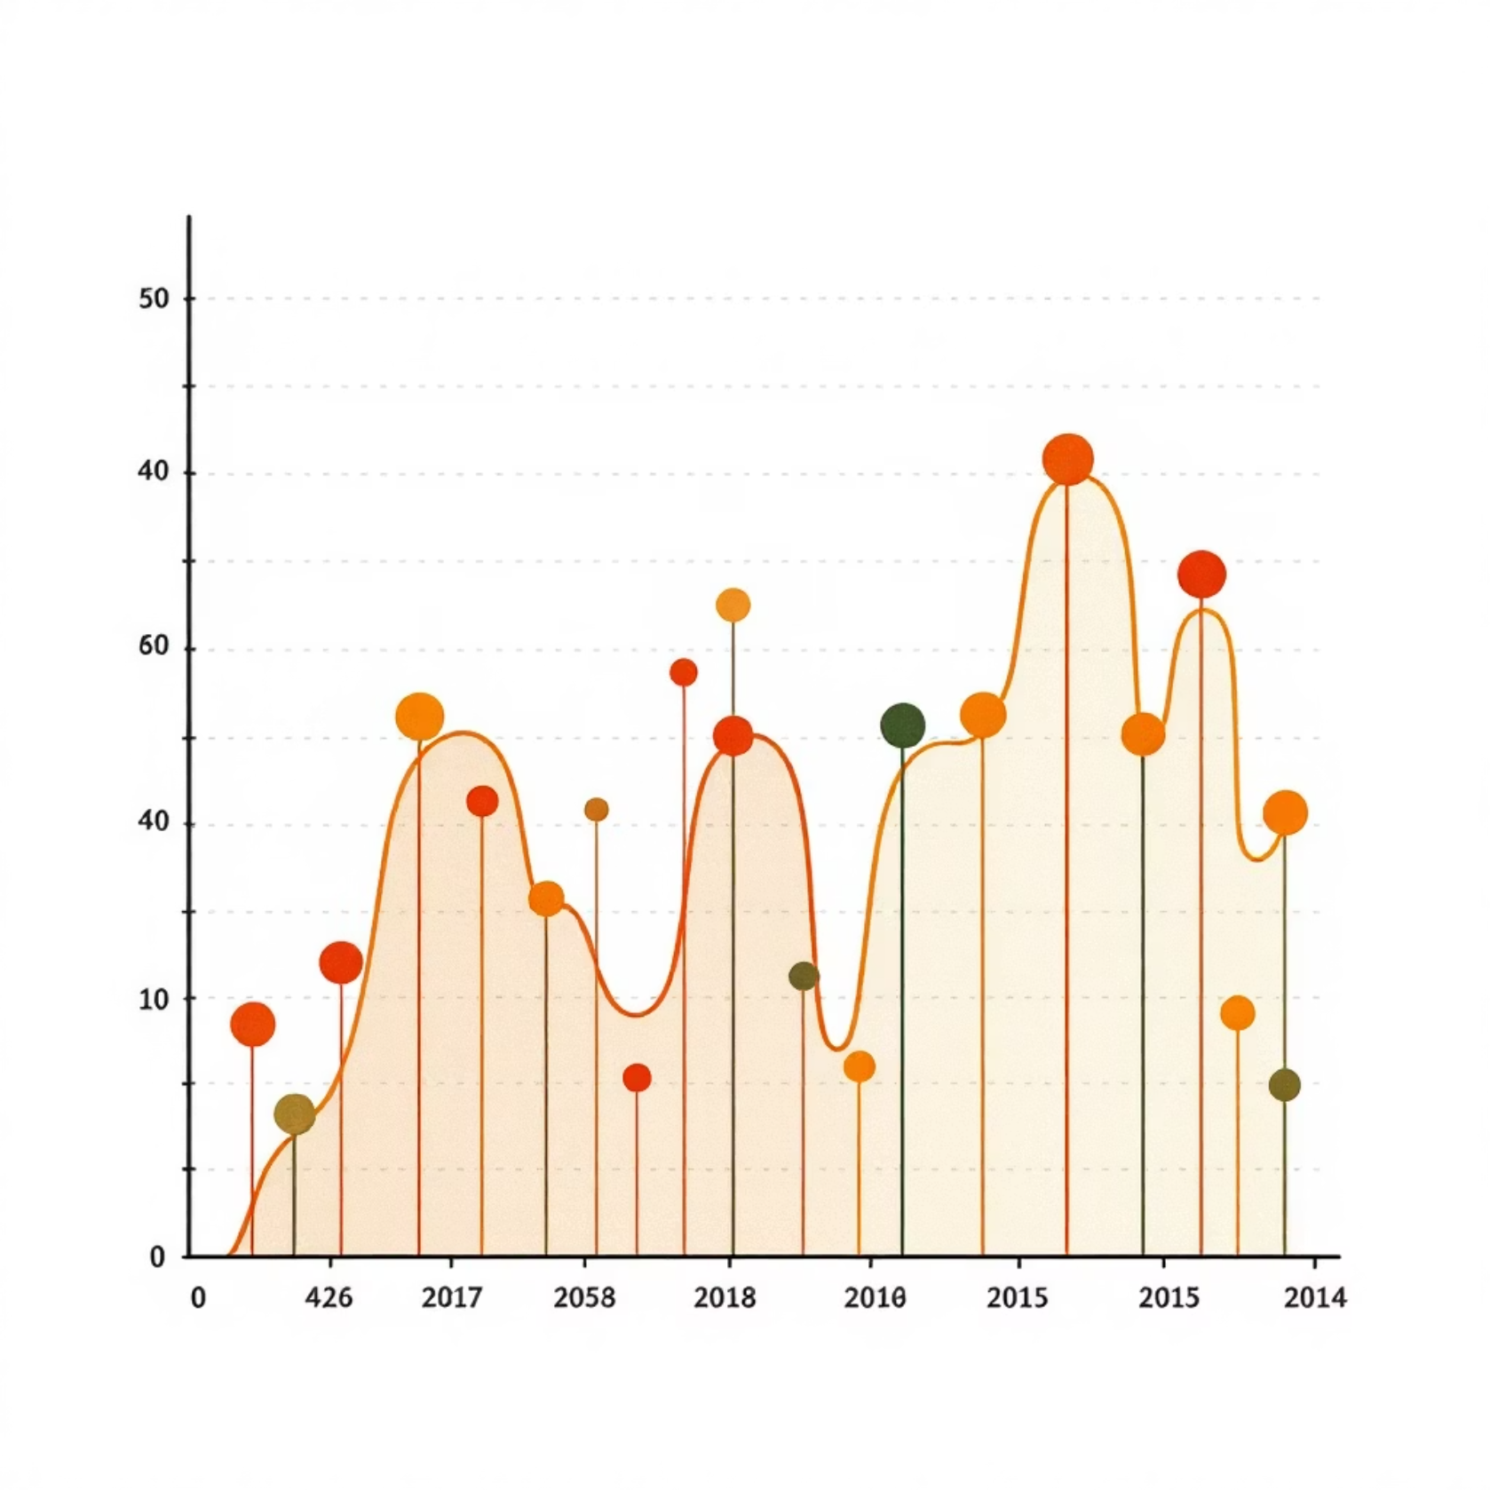
Age & Blood Group Analysis
Age Distribution
Insights into patient demographics across various age segments.
Highest Presence
Pinpointing the age group with the largest patient cohort.
Blood Group Dominance
Identifying the most prevalent blood group among patients.

Slide 19

Medical Condition Analysis
Patient Count by Disease
Highest Affected Conditions
Comparing prevalence of various medical conditions.
Focusing on diseases impacting the largest patient populations.
Age-Disease Variation
Observing how average age differs across medical conditions.

Slide 20
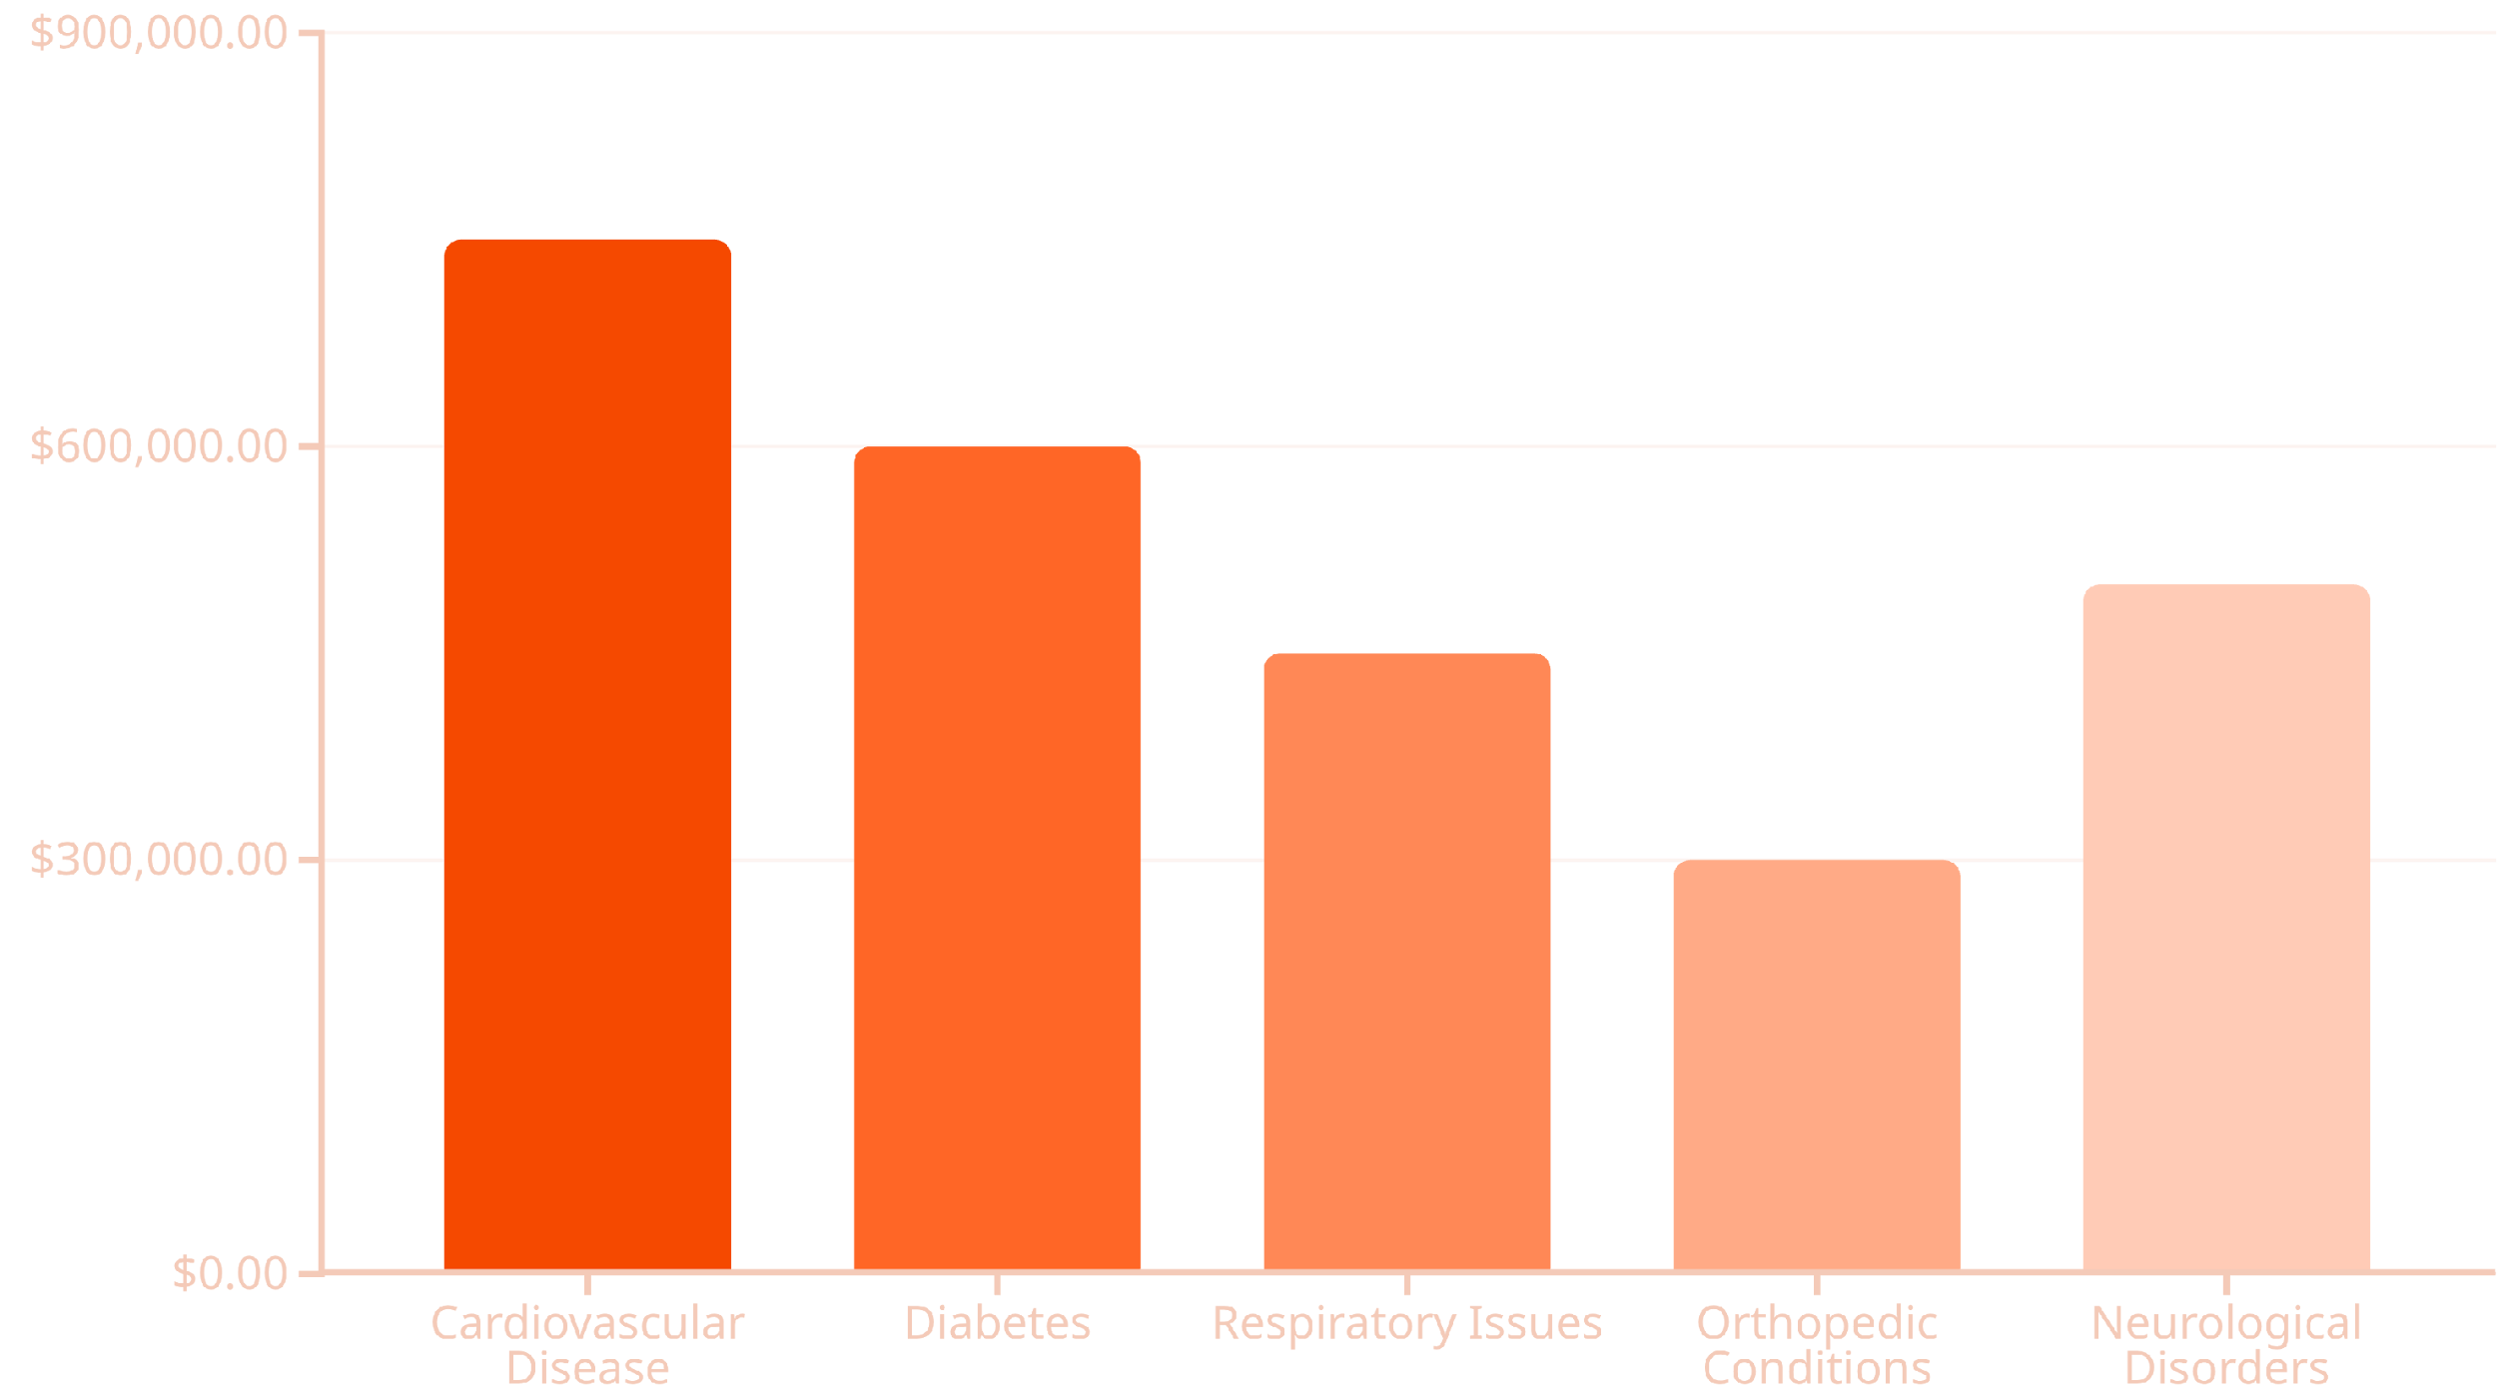
Billing Analysis by Medical Condition
Understanding financial contributions across different health issues.
Identifies diseases generating the highest revenue, critical for resource allocation and financial planning.

Slide 21

Insurance Insights: Coverage & Conditions
Insured Patient Overview
1
Analysis of patients benefiting from health insurance coverage.
Top Insured Conditions
2
Identification of medical conditions with the highest insurance coverage.
Policy Planning Support
3
Valuable data for shaping future healthcare policies and strategies.

Slide 22

Conclusion: Empowering Healthcare Decisions
Clear Insights
Dashboard offers comprehensive understanding of patient data.
Key Metrics Tracking
Monitors patient count, costs, and disease patterns effectively.
Strategic Support
Aids hospitals and management in critical decision-making.
Future Expansion
Potential for integration with real-time data for ongoing updates.

Slide 23
Thank You

